Slide 1
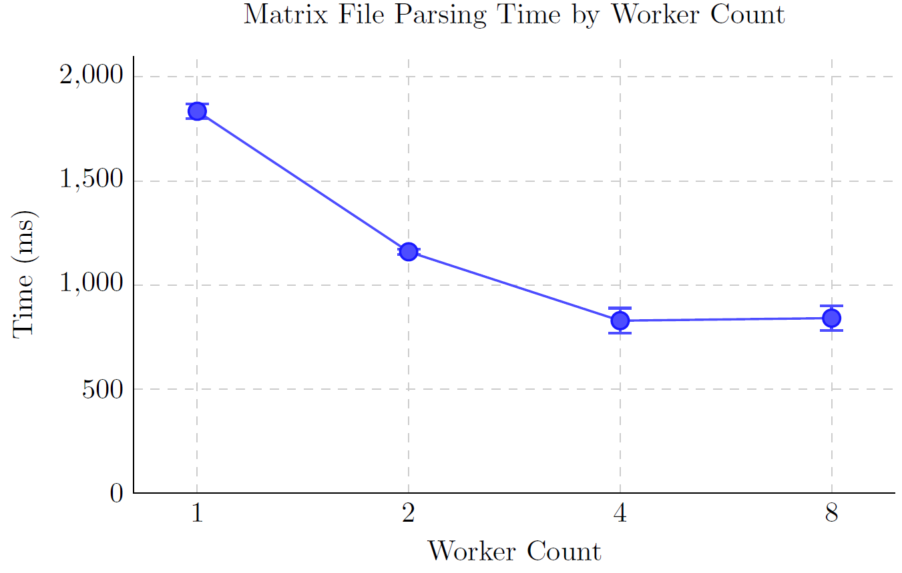

Slide 2
Optimization Strategies
Symmetry Exploitation:
  The inner product Ai · Aj equals Aj · Ai, so only the upper triangle is computed and the result is mirrored symmetrically.
Cache Blocking:
  Keeps the working set within the L1 cache.

Slide 3
Optimization Strategies
Multithreading with Equal Load Balancing:
  When ran with eight threads, tendency of threads returning with reversed order in which they were created was observed.
  However, when we assigned different load per thread, the computation time increased ~200%.
Assigning high priority to the process and the threads:
  Using SetThreadPriority Windows API function led to improvements in performance.

Slide 4
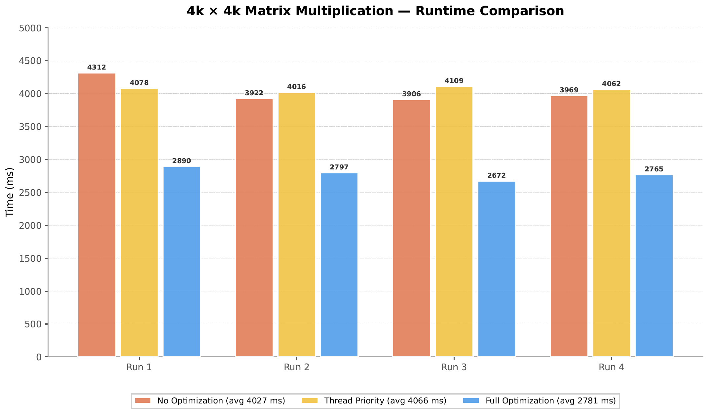
Result

