Slide 1
Multithreaded Operations on Windows
Seung-ri Shin (2023920029)

Slide 2
Operations without mutual exclusion
#include <Windows.h>
#include <stdio.h>
#define COUNT_OF_THREADS ((SIZE_T)1000)
HANDLE threads[COUNT_OF_THREADS];
CONST SIZE_T expected_sum = 10000000;
SIZE_T actual_sum = 0;
volatile LONG remaining = COUNT_OF_THREADS;
DWORD WINAPI job(LPVOID id)
{
SIZE_T i;
for (i = 0; i < expected_sum / COUNT_OF_THREADS; i++)
actual_sum++;
InterlockedDecrement(&remaining);
return 0;
}
int main(int argc, char *argv[])
{
int i;
for (i = 0; i < COUNT_OF_THREADS; i++)
{
threads[i] = CreateThread(
NULL, 0, job, (LPVOID)i, 0, NULL
);
if (!threads[i])
printf("[!] Failed to create thread %d!\n", i);
}
printf("[i] Waiting for the calculation...\n");
while (remaining > 0) Sleep(1);
printf("Expected: %lld\n", expected_sum);
printf("Actual: %lld\n", actual_sum);
return 0;
}

Slide 3
Operations without mutual exclusion
CreateThread 함수를 호출해, job() 함수의 주소를 시작 지점으로 정함.
job() 함수 내의 루프문에서는 actual_sum의 값을 증가시킴.
job() 함수가 리턴할 때 InterlockedDecrement 함수로 남은 스레드의 수를 atomic하게 1만큼 감소시킴.
모든 스레드가 작업을 끝내면 메인 스레드에서는 예상 값과 실제 값을 보여줌.

Slide 4
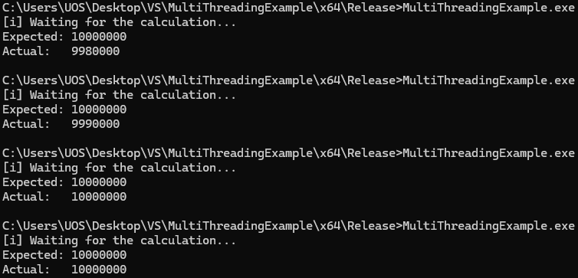
Operations without mutual exclusion

Slide 5
Operations with mutual exclusion
#include <Windows.h>
#include <stdio.h>
#define COUNT_OF_THREADS ((SIZE_T)1000)
HANDLE threads[COUNT_OF_THREADS];
HANDLE semaphore;
CONST SIZE_T expected_sum = 10000000;
SIZE_T actual_sum = 0;
volatile LONG remaining = COUNT_OF_THREADS;
DWORD WINAPI job(LPVOID id)
{
SIZE_T i;
for (i = 0; i < expected_sum / COUNT_OF_THREADS; i++)
{
WaitForSingleObject(semaphore, INFINITE);
actual_sum++;
ReleaseMutex(semaphore);
}
InterlockedDecrement(&remaining);
return 0;
}
int main(int argc, char *argv[])
{
int i;
semaphore = CreateMutex(NULL, FALSE, NULL);
for (i = 0; i < COUNT_OF_THREADS; i++)
{
threads[i] = CreateThread(
NULL, 0, job, (LPVOID)i, 0, NULL
);
if (!threads[i])
printf("[!] Failed to create thread %d!\n", i);
}
printf("[i] Waiting for the calculation...\n");
while (remaining > 0) Sleep(1);
printf("Expected: %lld\n", expected_sum);
printf("Actual: %lld\n", actual_sum);
CloseHandle(semaphore);
return 0;
}

Slide 6
Operations with mutual exclusion
Windows API에서는 최댓값이 1인 세마포어를 Mutex라고 정의함.
이 예시에서는 스레드가 WaitForSingleObject() 함수를 호출해 뮤텍스를 획득한 후 actual_sum을 증가시킴.
임계 영역을 빠져나갈 때 ReleaseMutex() 함수를 호출해 세마포어의 값을 하나 증가시킴.

Slide 7

Operations with mutual exclusion

